Slide 1
Reliable Task Scheduling in Heterogeneous Distributed Systems
MEMBERS:
Bhirundha M (201306006)
Raja Priya P (201306035)
Sri Sruthi S (201306054)
GUIDE:
Mrs. S. SAROJA, AP(Sr.Grade)
Department of Information Technology
Mepco Schlenk Engineering College
Department of IT

Slide 2
Objective
To reduce the expected execution time by replicating the tasks.
To implement two phase algorithm
  First Phase - Find favorable number of replication of tasks
  Second phase - Scheduling algorithm
Consists of two Strategies
  First strategy - No replication of tasks can be stopped
  Second strategy - Once the replication of a task is completed the other replicas are stopped
Department of IT

Slide 3
Notations
Topology of Distributed System:
Undirected Graph : GT = ( P , L )
P – Set of m processors (p₁ , p₂ ,… p_{m} ) .
L – Set of Links.
l_{i,j} - Bidirectional Communication link between p_{i} , p_{j}
w (p_{i}) – weight of p_{i} (Computation Capacity).
w(l_{i,j}) - weight of edge l_{i,j.} (Communication Capacity).
Department of IT

Slide 4
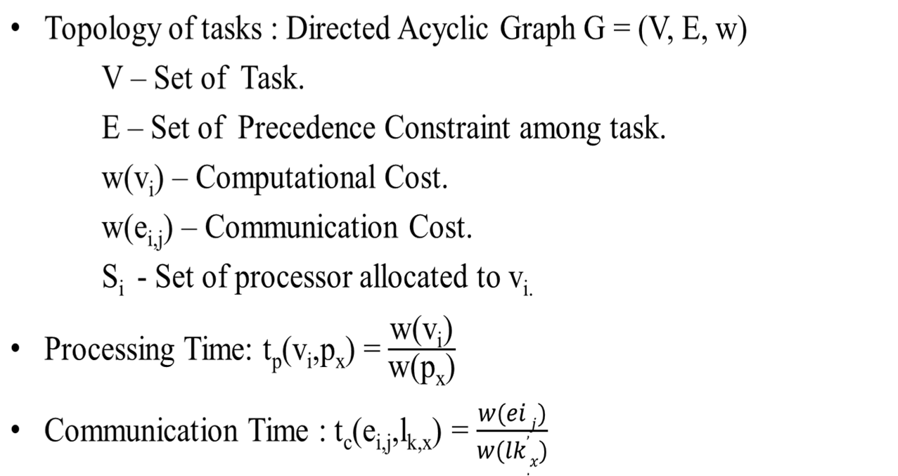
Notations (contd..)
Department of IT

Slide 5




Flow Diagram
Start
Compute RRank
Generate task graph
Read inputs from files
Sort Task according to the RRank in descending order
Normalize the parameters
Schedule the task
Calculate allotment lower bound for each task
Scheduled task with processors
Compute allotment parameter
Stop
A
Department of IT

Slide 6
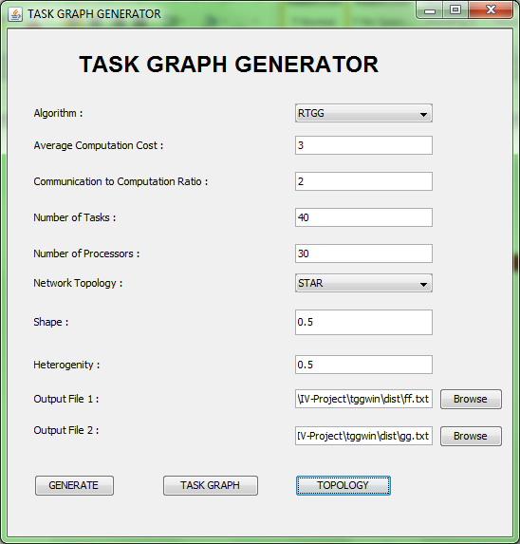
Task Graph Generator (TGG)
Department of IT

Slide 7
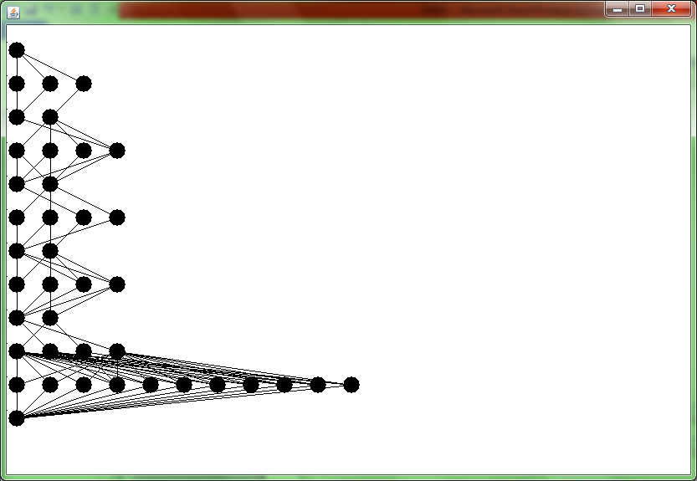
Department of IT

Slide 8
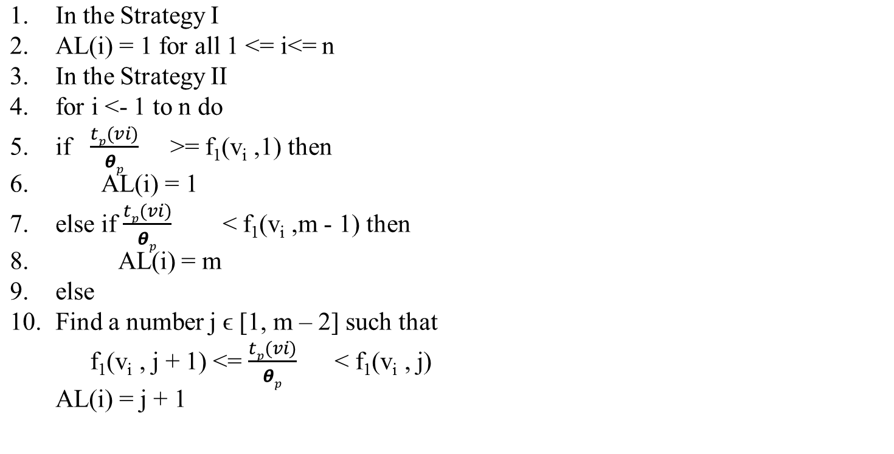
Allotment Problem
Methodologies
Allotment Lower Bound
Department of IT

Slide 9
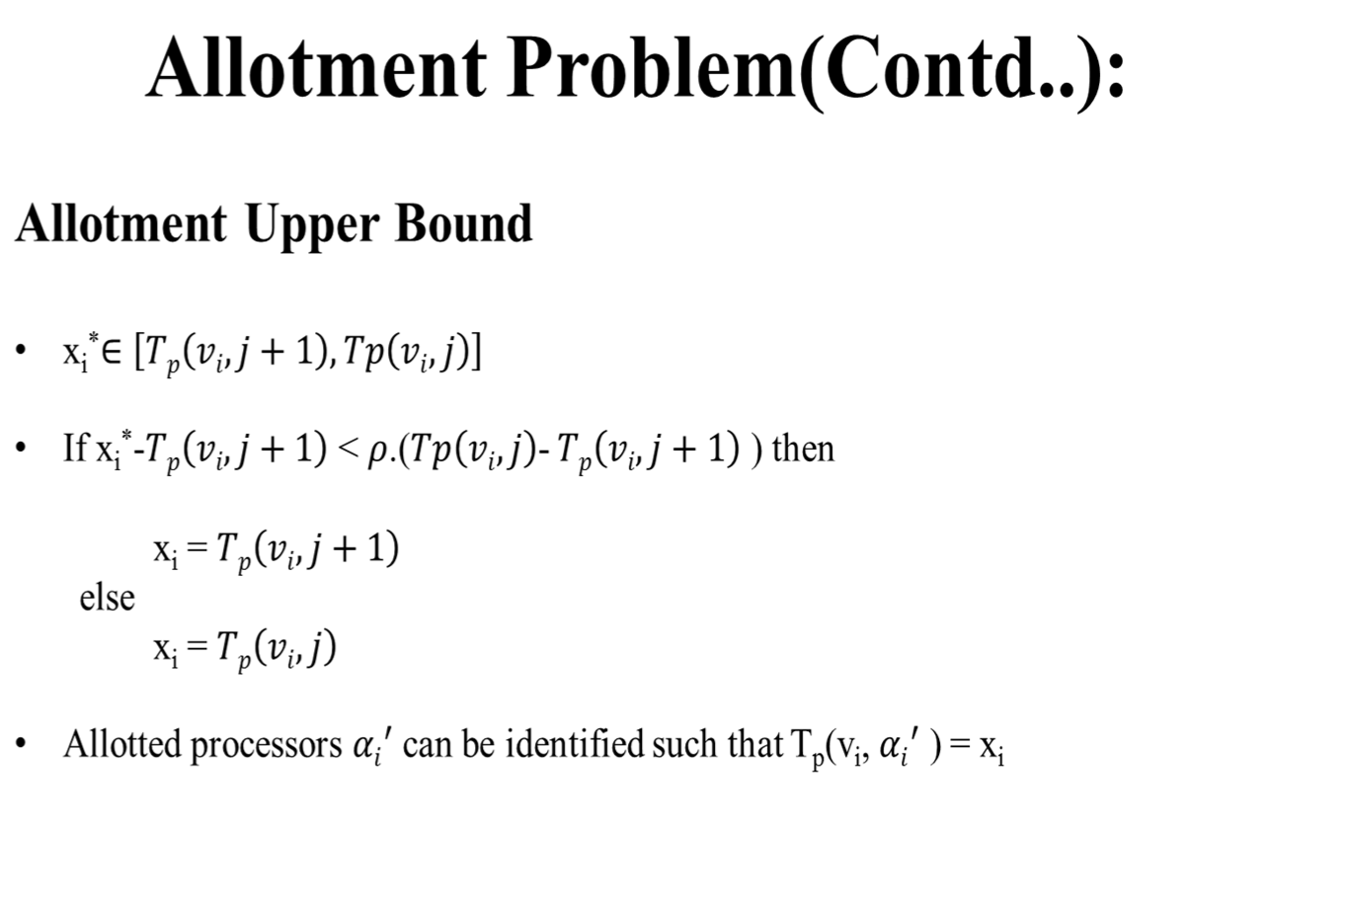
Department of IT

Slide 10
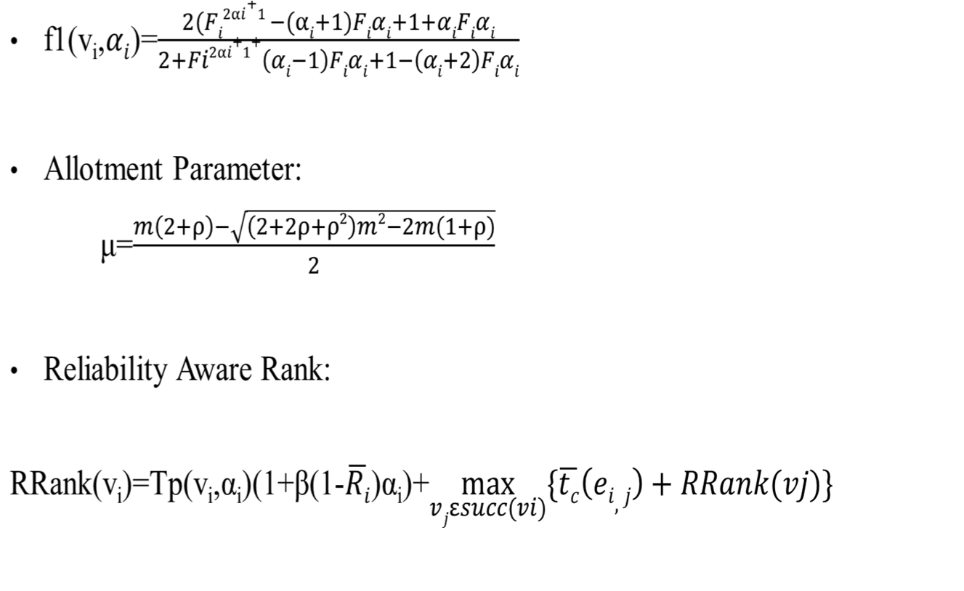
Allotment Problem (Contd..)
Department of IT

Slide 11
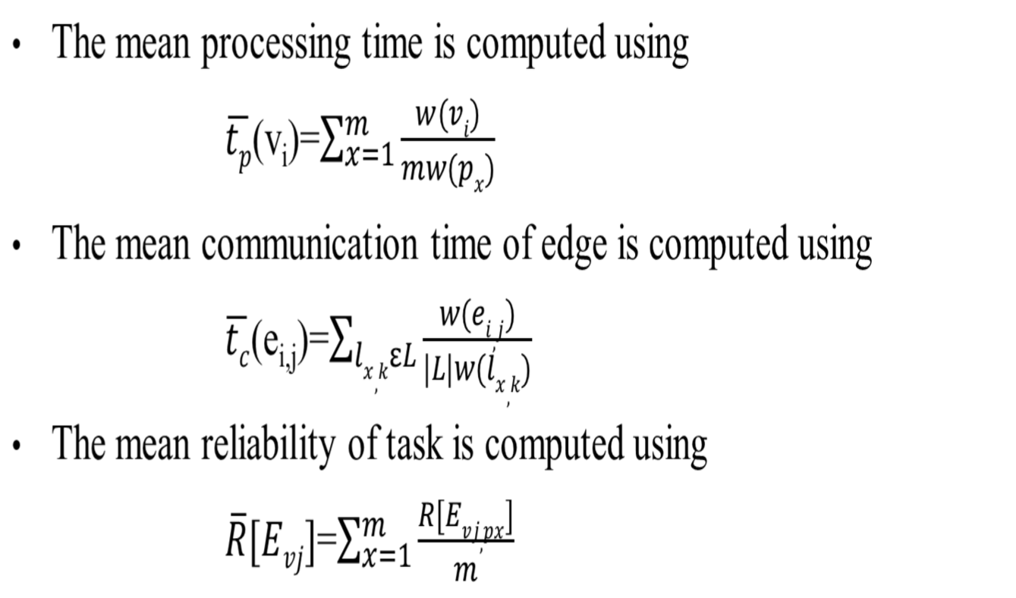
Normalization Steps
Department of IT

Slide 12
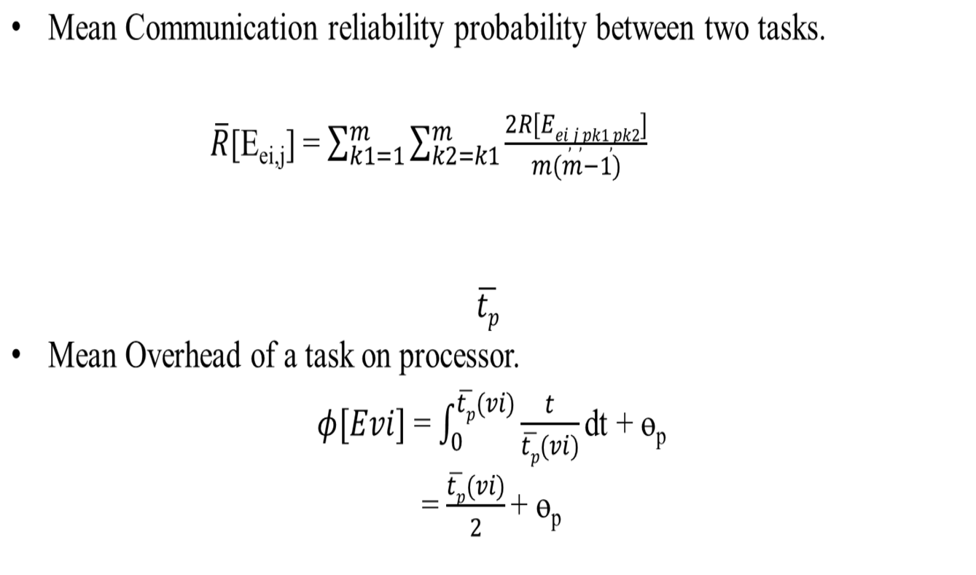
Normalization Steps (Contd..)
Department of IT

Slide 13
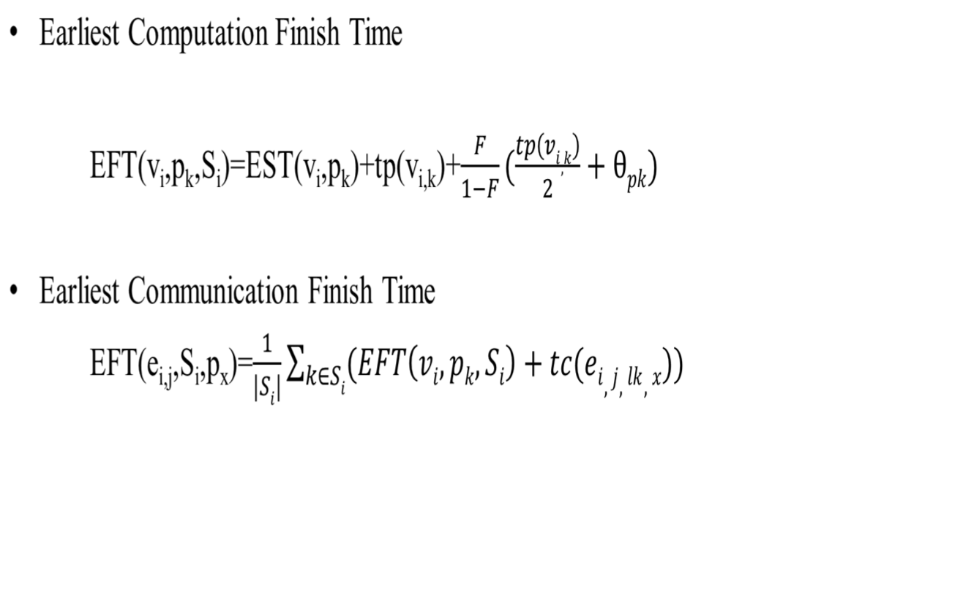
Makespan Problem
Department of IT

Slide 14
Proposed Algorithm
Allotment Aware Scheduling
Normalize the heterogeneous system into a homogeneous system.
Compute allotment parameter α’ by the linear program and the rounding procedure.
Compute α_{i} = max {min {α’_{i} , µ}, AL (i)} for v_{i} ϵ V.
Compute RRank for all tasks by traversing graph from the exit task.
Sort the tasks in a scheduling list by non – increasing order of RRank
Department of IT

Slide 15
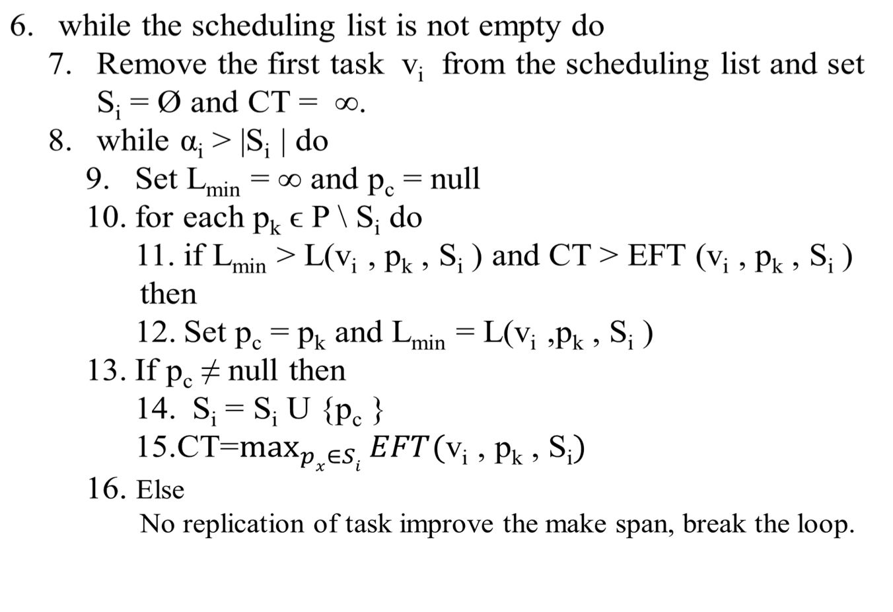
Department of IT

Slide 16
The Expected Time Procedure
Compute the reliability probability R = e-λtp(v,p) for the task v on the processor p and set t = tp(v,p).
Get the number n ϵ [0, 1] uniformly at random.
while n > R do
Get a number p ϵ [0, 1] uniformly at random.
t = t + p x tp(v, p) + ϴ
Get a number n ϵ [0, 1] uniformly at random.
Department of IT

